Slide 1
COMP 2100
Week 7 - Monday

Slide 2
Last time
What did we talk about last time?
Traversals
BST delete

Slide 3
Questions?

Slide 4
Project 2
Infix to Postfix Converter

Slide 5
Breadth First Search

Slide 6
What if we didn’t have a BST?
Maybe we still have a binary tree, but we don’t have any guarantees about ordering
How would you search for something?
We could use preorder or postorder traversals
These are types of depth first searches
You go to the bottom of the tree before you come back
What if we thought what we are looking for might be close to the top?

Slide 7
Level order traversal
The most logical breadth first traversal visits each level of a tree in order:
10 6 14 1 9 . 17 . 2 7 . 15 . . . . . . .
10
6
14
1
9
17
2
7
15

Slide 8
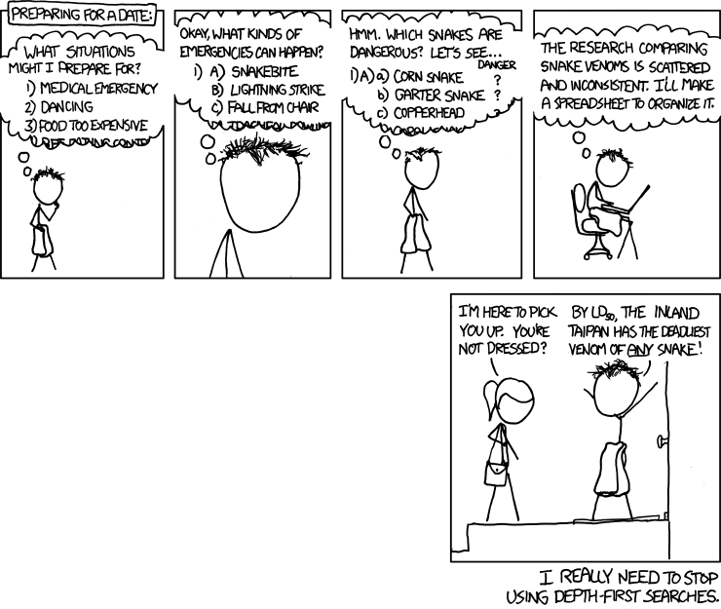
Breadth first search and dating
From: http://xkcd.com/761/

Slide 9
Breadth first algorithm
For depth first traversals, we used a stack
What are we going to use for a BFS?
A queue!
Algorithm:
Put the root of the tree in the queue
As long as the queue is not empty:
Dequeue the first element and process it
Enqueue all of its children

Slide 10
Breadth first implementation
Write a level order (breadth first) traversal
Hint: Use an explicit queue
Non-recursive!
public void levelOrder()

Slide 11
2-3 Trees
Balance in all things

Slide 12
2-3 trees
A 2-3 search tree is a data structure that maintains balance
It is actually a ternary tree, not a binary tree
A 2-3 tree is one of the following three things:
An empty tree (null)
A 2-node (like a BST node) with a single key, smaller data on its left and larger values on its right
A 3-node with two keys and three links, all key values smaller than the first key on the left, between the two keys in the middle, and larger than the second key on the right

Slide 13
2-3 tree properties
The key thing that keeps a 2-3 search tree balanced is that all leaves are on the same level
Only leaves have null links
Thus, the maximum depth is somewhere between the log₃n (the best case, where all nodes are 3-nodes) and log₂n (the worst case, where all nodes are 2-nodes)

Slide 14
How does that work?
We build from the bottom up
Except for an empty tree, we never put a new node in a null link
Instead, you can add a new key to a 2-node, turning it into a 3-node
Adding a new key to a 3-node forces it to break into two 2-nodes

Slide 15
Simplest case: empty tree
Starting with an empty tree, we put in a new 2-node:
X
19
Add 19

Slide 16
Next case: add to 2-node
When adding to a 2-node, make it a 3-node, we put in a new 2-node:
19
19
35
Add 35

Slide 17
Next case: add to 3-node
When adding to a 3-node, the 3-node breaks into two 2-nodes, bringing the middle value up:
19
35
19
Add 4
4
35

Slide 18
Adding to a 3-node continued
When breaking a 3-node into two parts, you move the middle value up
If the node above is empty, it's a new 2-node
If the node above is a 2-node, it becomes a 3-node
If the node above is another 3-node, it also breaks into 2-nodes, which might cascade up the tree

Slide 19
2-3 tree practice
Add the following keys to a 2-3 tree:
62
11
32
7
45
24
88
25
28
90

Slide 20
2-3 tree running times
Because of the guarantees about the depth of the tree, we the following running times for 2-3 search trees
Θ(log n) insert
Θ(log n) delete (messy, but true)
Θ(log n) find (not that different from a BST find)

Slide 21
2-3 tree implementation
How do we implement a 2-3 tree?
Answer: We don't.
It is (of course) possible, but it involves having weird 2-nodes and 3-nodes that inherit from some abstract node class or interface
It's a huge pain
Note that 2-3 trees are essentially a special case of a B-tree, and someone does have to implement those
Instead, we use red-black trees which are structurally the same as 2-3 trees (if you squint)

Slide 22
Red-black trees

Slide 23
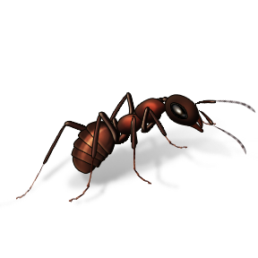
An interlude in a formicary
One hundred ants are walking along a meter long stick
Each ant is traveling either to the left or the right with a constant speed of 1 meter per minute
When two ants meet, they bounce off each other and reverse direction
When an ant reaches an end of the stick, it falls off
Will all the ants fall off?
What is the longest amount of time that you would need to wait to guarantee that all ants have fallen off?

Slide 24
"As if"
On the previous slide, we can look at the problem "as if" ants were passing through each other with no effect
This idea of looking at a problem as if it is something else can make solving it easier
Coding up a 2-3 tree is annoying (but possible)
By creating a data structure that is (somehow) equivalent, we can get the job done in an easier way
Sometimes the way we implement an algorithm and the way we analyze it are different

Slide 25
Red-black trees
A red-black tree is a form of binary search tree
Each node looks like a regular BST node, with one additional piece of information: color
A node can either be red or black
Null values are considered black
The color allows us to simulate a 2-3 tree
We can think of a red node is actually part of a 3 node with its parent

Slide 26
Red-black tree definition
A red-black tree is a BST with red and black nodes and the following properties:
Red nodes lean left from their parents
No node has two red children
The tree has perfect black balance
In other words, every path from the root to a null has the same number of black nodes on the way
The length of this path is called the black height of the tree
The book describes the link as having a color (which is probably easier to think about), but the color has to be stored in the node

Slide 27
2-3 tree mapping to a red-black tree
M
M
E
J
R
J
R
A
C
H
L
P
S
X
E
L
P
X
C
H
S
A

Slide 28
Building the tree
We can do an insertion with a red-black tree using a series of rotations and recolors
We do a regular BST insert
Then, we work back up the tree as the recursion unwinds
If the right child is red, we rotate the current node left
If the left child is red and the left child of the left child is red, we rotate the current node right
If both children are red, we recolor them black and the current node red
You have to do all these checks, in order!
Multiple rotations can happen
It doesn't make sense to have a red root, so we always color the root black after the insert

Slide 29
Left rotation
Current
Current
X
Y
A
C
Y
X
B
C
A
B
We perform a left rotation when the right child is red

Slide 30
Right rotation
Current
Current
Z
Y
D
Y
Z
X
C
A
B
C
D
X
A
B
We perform a right rotation when the left child is red and its left child is red

Slide 31
Recolor
Current
Current
Y
Y
X
Z
X
Z
A
B
C
D
A
B
C
D
We recolor both children and the current node when both children are red

Slide 32
Red-black tree practice
Add the following keys to a red-black tree:
62
11
32
7
45
24
88
25
28
90
Hint: Add to a 2-3 tree, then convert to red-black

Slide 33
Analysis of red-black trees
The height of a red-black tree is no more than 2 log n
Find is Θ(height), so find is Θ(log n)
Since we only have to go down that path and back up to insert, insert is Θ(log n)
Delete in red-black trees is messy, but it is also actually Θ(log n)

Slide 34
Upcoming

Slide 35
Next time…
Finish red-black trees
AVL trees
Balancing trees by construction

Slide 36
Reminders
Keep working on Project 2
Due Friday!
Keep reading Section 3.3

